Slide 1


WELCOME
Welcome to the Presentation
Engineering economics
Course Code: GED 221
MD Abdullah Al Noman
Lecturer , DBA, BAIUST
Bangladesh Army International University of Science and Technology

Slide 2
CONSTITUENTS OF THE PRESENTATION
Demand
Law of Demand
Factors affecting Demand
Demand function
Supply
Law of Supply
Factors affecting Supply
Supply function

Slide 3
Demand
In ordinary speech, the word demand is often confused with desire. Desire is the wish to have something or to enjoy a service. But demand implies more than mere desire. It means that the person is willing and able to pay for the object he desire. In economics, demand refers to the quantity of a good or service that consumers are willing and able to purchase at various prices over a given period of time.
A beggar’s desire to travel by air from Delhi to Bombay has no signifies as he cannot pay for it. On the other hand, a businessman’s desire to go to Bombay by air is demand, as he is able to pay for it and is willing to do so. Demand thus means desire backed by willingness and ability to pay.
Both willingness and ability to pay are essential. If a man is willing to pay but he is unable to pay, his desire will not become demand. In the same manner, if he is able to pay but is not willing to pay, his desire will not be changed into effective demand. In order to change desire into demand, it is essential that he should be both willing and able to pay.

Slide 4
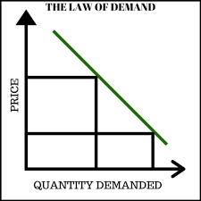
Law of Demand
The law of demand states that, all else being equal, there is an inverse relationship between the price of a good or service and the quantity demanded by consumers. As the price of a good rises, the quantity demanded tends to decrease; conversely, as the price falls, the quantity demanded generally increases.

Slide 5
Factors affecting Demand
These factors include:
Price of the Good or Service: The primary factor, as dictated by the law of demand, is that an increase in price generally decreases quantity demanded, and a decrease in price increases it, assuming other factors remain constant.
Consumer Income: Higher income levels tend to increase demand for goods and services, as people have more purchasing power. Conversely, a drop in income typically reduces demand. Normal goods see increased demand with rising income, while demand for inferior goods may decrease.
Prices of Related Goods: Demand can be influenced by the prices of complementary goods (goods that are often used together) and substitute goods (goods that can replace one another):
  Complements: If the price of a complementary good decreases, demand for the related good might increase. For instance, if the price of coffee falls, demand for sugar (a complement) may rise.
  Substitutes: If the price of a substitute good increases, demand for the original good may rise, as consumers switch to the more affordable option.

Slide 6
Factors affecting Demand
4. Consumer Preferences and Tastes: Changes in trends, fashions, or consumer preferences can increase or decrease demand for particular goods. Marketing, cultural influences, and public perceptions often play roles in shaping preferences.
5. Expectations of Future Prices and Income: If consumers expect prices to rise in the future, they may buy more now, increasing current demand. Likewise, if they expect a rise in income, they might increase current spending.
6. Number of Buyers in the Market: An increase in the population or in the number of consumers for a good will generally increase demand, while a decrease will reduce it.
7. Seasonal Factors: Certain goods experience demand fluctuations based on seasons or weather. For instance, the demand for winter clothing spikes during colder months.
Each of these factors can cause shifts in the demand curve, either increasing or decreasing demand independently of the good’s own price.

Slide 7
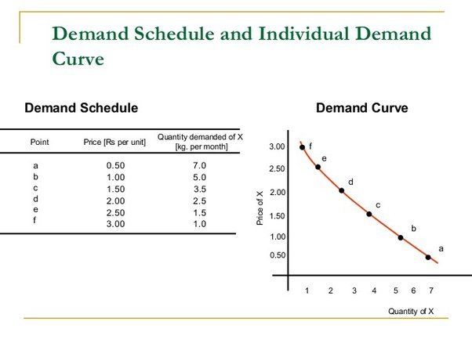
Demand Schedule
A demand schedule is a table showing how much of a given product a household would be willing to buy at different prices. Demand curves are usually derived from demand schedules.

Slide 8
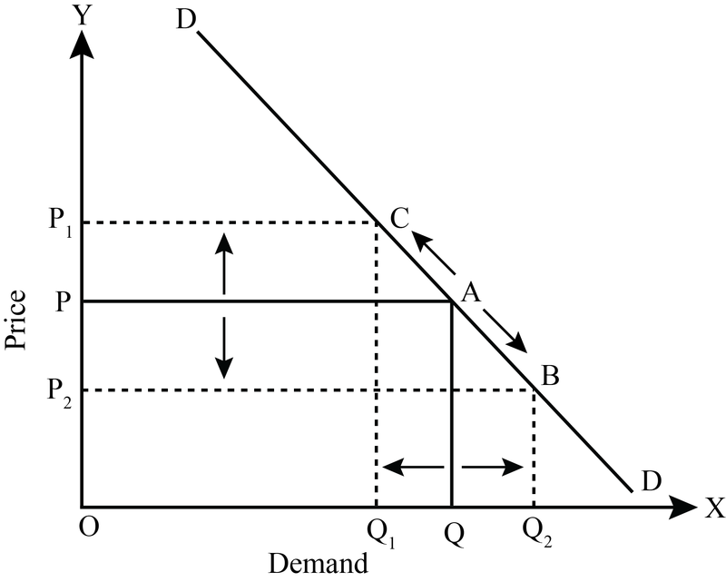
Changes in Demand vs Changes in Quantity Demand
1. Change in Quantity Demanded
A change in quantity demanded refers to a movement along the demand curve due to a change in the price of the good or service itself.
When the price decreases, the quantity demanded increases, and when the price increases, the quantity demanded decreases, following the law of demand.
This is represented as a movement from one point to another on the same demand curve. For example, if the price of coffee drops from $5 to $3, the quantity demanded might increase from 100 to 150 cups per day.

Slide 9
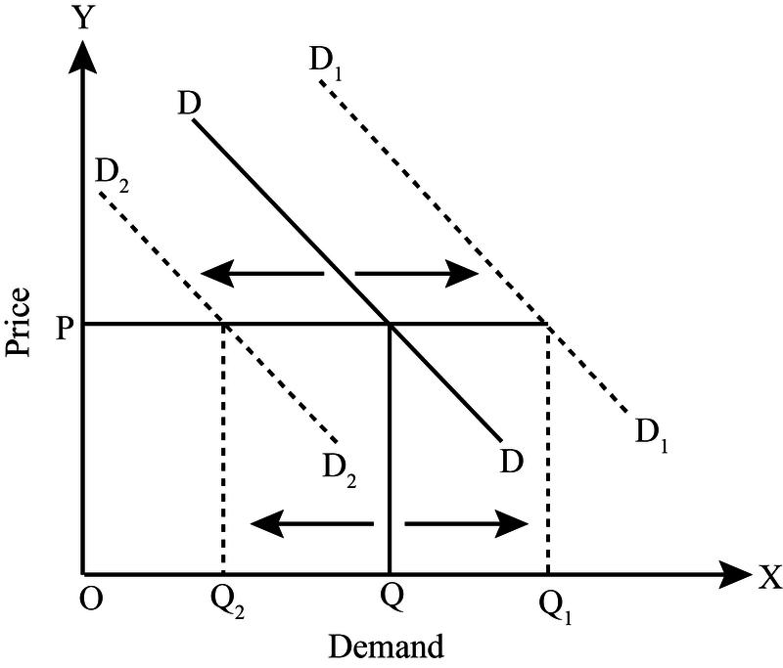
Changes in Demand vs Changes in Quantity Demand
2. Change in Demand
A change in demand, on the other hand, refers to a shift of the entire demand curve, either to the right (increase in demand) or to the left (decrease in demand).
This shift occurs when factors other than the price of the good itself change, such as:
  Consumer income
  Prices of related goods (complements and substitutes)
  Consumer preferences
  Future expectations about prices or income
  Changes in the number of buyers

Slide 10
Changes in Demand vs Changes in Quantity Demand
For example, if there’s an increase in consumer income, people might be willing to buy more coffee at all price levels, shifting the demand curve to the right.
In summary:
A change in quantity demanded is a response to a price change for that specific good, resulting in movement along the demand curve.
A change in demand is a shift of the entire curve due to factors other than the good’s own price.

Slide 11
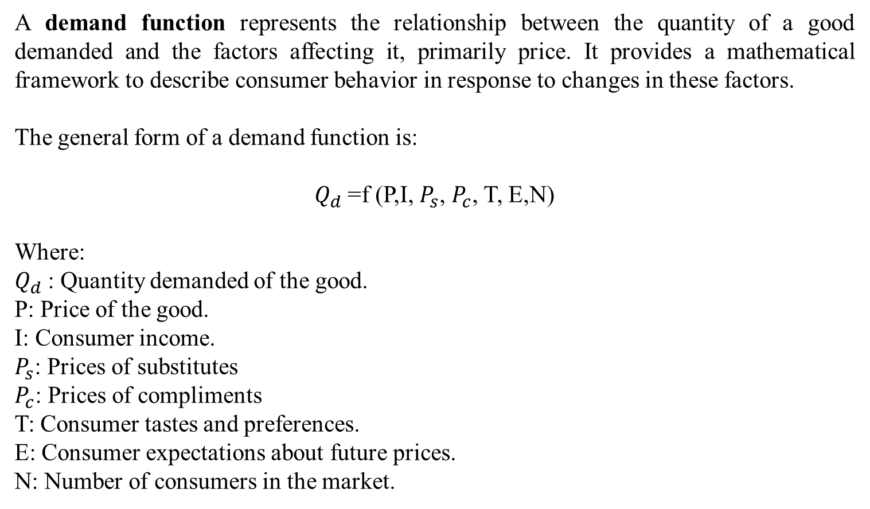
Demand function

Slide 12
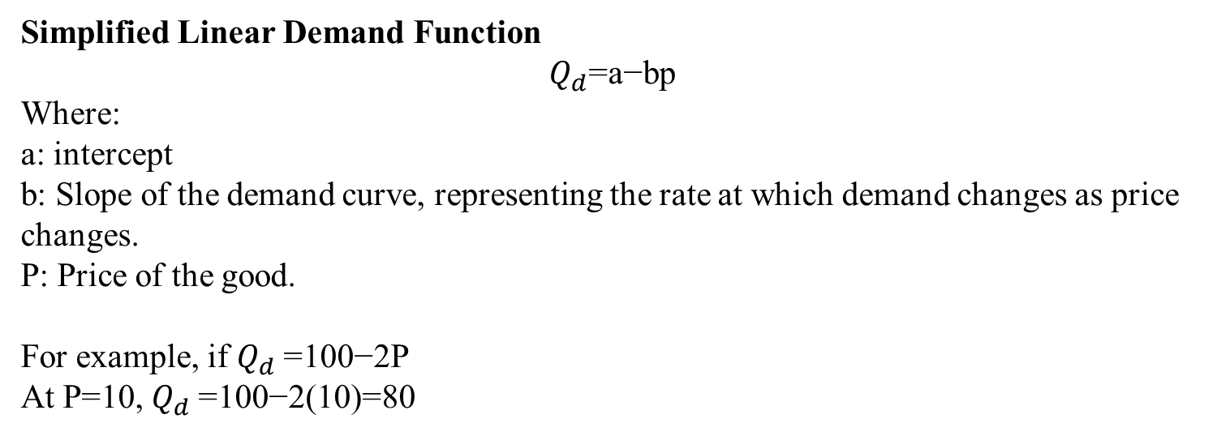
Demand function

Slide 13
Exceptions to the Law of Demand
Giffen Goods is a concept that was introduced by Sir Robert Giffen. The unique characteristic of Giffen goods is that as its price increases, the demand also increases.
A Giffen good, a concept commonly used in economics, refers to a good that people consume more as the price rises. Therefore, a Giffen good shows an upward-sloping demand curve and violates the fundamental law of demand.
Giffen goods are basic, low-quality essential goods. When price rises, people get poorer in real terms. Since they can’t afford better substitutes, they cut back on expensive food and buy more of the cheap staple, even at the higher price.

Slide 14
Exceptions to the Law of Demand
The second exception to the law of demand is the concept of Veblen goods. Veblen Goods is a concept that is named after the economist Thorstein Veblen. Veblen goods are mostly luxury, status-symbol items—like perfumes and certain cars—that see their demand climb as their prices rise.
According to Veblen, there are certain goods that become more valuable as their price increases. If a product is expensive, then its value and utility are perceived to be more, and hence the demand for that product increases.
And this happens mostly with precious metals and stones such as gold and diamonds and luxury cars such as Rolls-Royce. As the price of these goods increases, their demand also increases because these products then become a status symbol.

Slide 15
Exceptions to the Law of Demand
Another exception to the law of demand is necessary or basic goods. People will continue to buy necessities such as medicines or basic staples such as sugar or salt even if the price increases.
Sometimes the demand for a product may change according to the change in income. If a household’s income increases, they may purchase more products irrespective of the increase in their price, thereby increasing the demand for the product. Similarly, they might postpone buying a product even if its price reduces if their income has reduced.

Slide 16
Exceptions to the Law of Demand
Bandwagon Effect: This is the most common type of exception to the law of demand wherein the consumer tries to purchase those commodities which are bought by his friends, relatives or neighbors. Here, the person tries to emulate the buying behavior and patterns of the group to which he belongs irrespective of the price of the commodity.
For example, if the majority of group members have smart phones then the consumer will also demand for the smartphone even if the prices are high.

